Slide 1

Acknowledgement of Country
I would like to acknowledge the Bedegal people as the Traditional Custodians of this land. I would also like to pay my respects to the Elders, past and present, and extend that respect to other Aboriginal and Torres Strait Islanders who are present here today.
Notes:
Aboriginal and Torres Strait Islander people have made and are continuing to make extraordinary contributions to the scientific community and I think it likely that the future of sustainability and biodiversity here will depend on enabling and enacting Indigenous-driven solutions.

Slide 2
SCIF2001 – Workshop 1
General Overview

Slide 3
Today's Plan
Course Introduction and Overview!
Q and A time + we’ll be taking live questions on SLIDO
Continuing on from SCIF1000/SCIF1001
Meet your Research Groupmates
Science Societal Impact Challenges
Getting ready for your first meeting (Week 2)

Slide 4
Course Introduction
Why are you here, how do you pass?

Slide 5
Course Intention
Take Your First Steps as a Researcher!
This course will likely be your first experience engaging in authentic research.
Learn the tools of the trade.
You’ll be developing key skills to become a researcher, at the small scale (data processing, experimental technique) and more meta-cognitiviely (research planning, ethics)
Have Fun!
This course is Competency-Based and does not affect your WAM, so you can focus on making the most of your experience. Crucially, you’ll learn that in research nothing ever goes as planned.

Slide 6
Projects at the Centre
W/S 1
SCIF2001 is a project-based course.
W/S 6
Your Project
W/S 2
W/S 3
The weekly workshops supplement the projects and provide important skills development.
W/S 4
W/S 5

Slide 7
Projects – an Overview
Based on your preferences, you’ve been sorted into a project group.
You will be working in this project group for the term.
Each project group will have:
Dedicated classroom time in a relevant laboratory.
An academic in charge and a PhD student Project Leader / mentor.
A group of peers to work with!

Slide 8
Projects are all different
Some projects are data-analysis heavy, some are very physical/practical.
Some have large scope for individual work, others need to be collaborative to function.
Check in with your project leader to see what your project will be like!

Slide 9
Projects - Assessments
We’ll see more about this later!
Literature Review / Project Plan
You’ll write a literature review and project plan.
It’s due in Week 4
Science Skills
You’ll demonstrate scientific skills throughout the term.
You’ll be assessed against a project / discipline specific rubric twice through the term.
Presentation
You’ll record a 6 minute academic video summarizing your work..
You’re expected to outline the impact of your project, your specific contributions, and explain any science.
It’s due in Week 11
ALL three of these are marked by your Project Leaders.
Rubrics are available on Moodle!

Slide 10
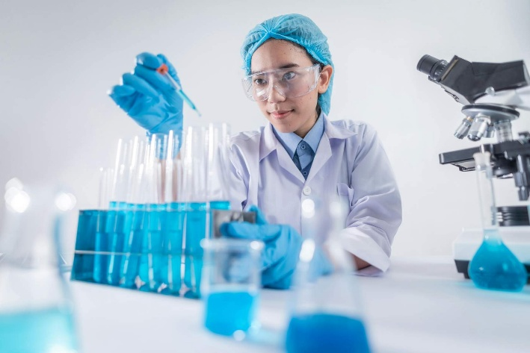
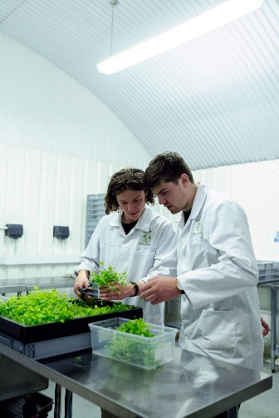

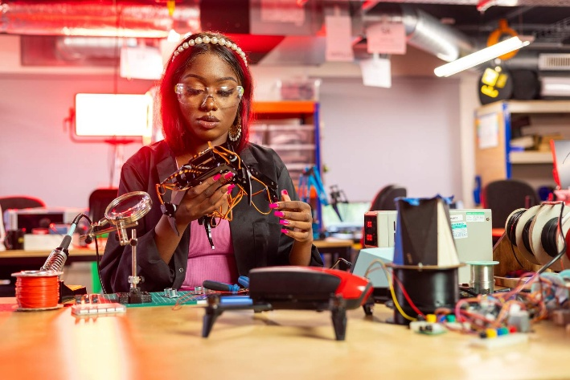
Laboratory Session
Project Time!
You’re all scheduled to different times – be sure to check your timetable for where and when!
Four hours at a time – total 28 hours and you need to engage actively in 20 hours to pass the course.
Mentors will be judging this.

Slide 11
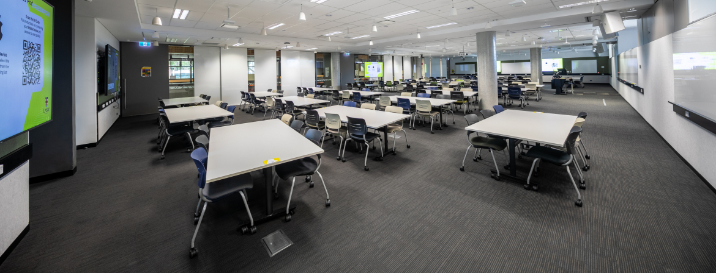
Activity! – Go Find your group
Each table has a paper label with a group name and number – go find yours!
Each member of the group should
Introduce themselves and their degree
Why are you taking SCIF2001?
What do you hope to gain out of the course?

Slide 12
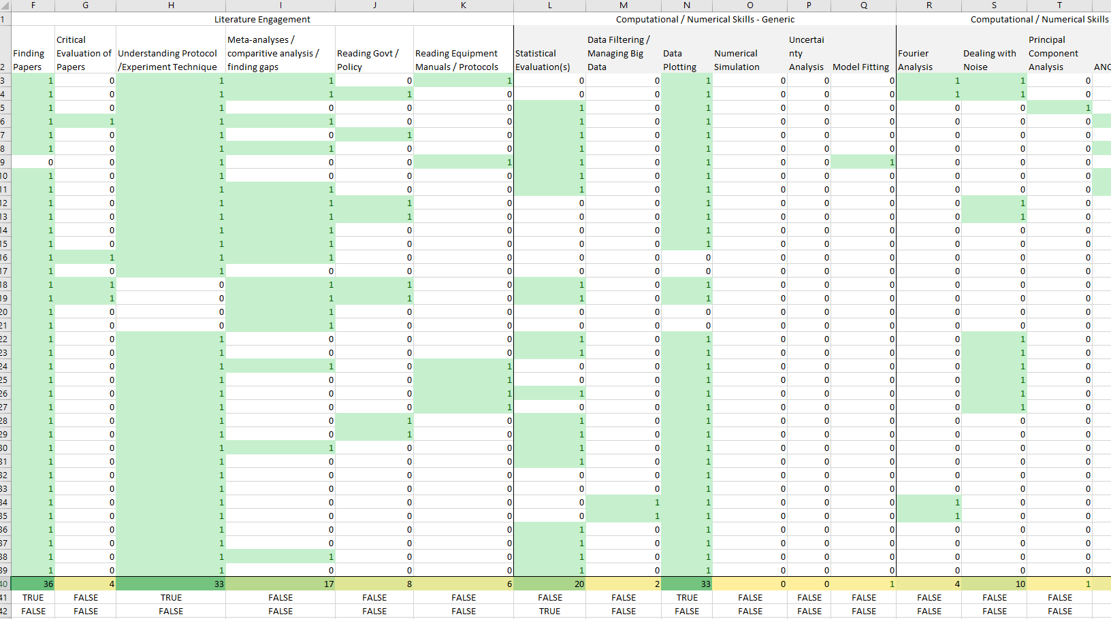
Workshops – an Overview
The workshops of this course are:
Cross-cohort
Project Agnostic
Focused on important skills
I went through every project in 2025 and mapped the necessary skills – so they’re going to be relevant to you!

Slide 13
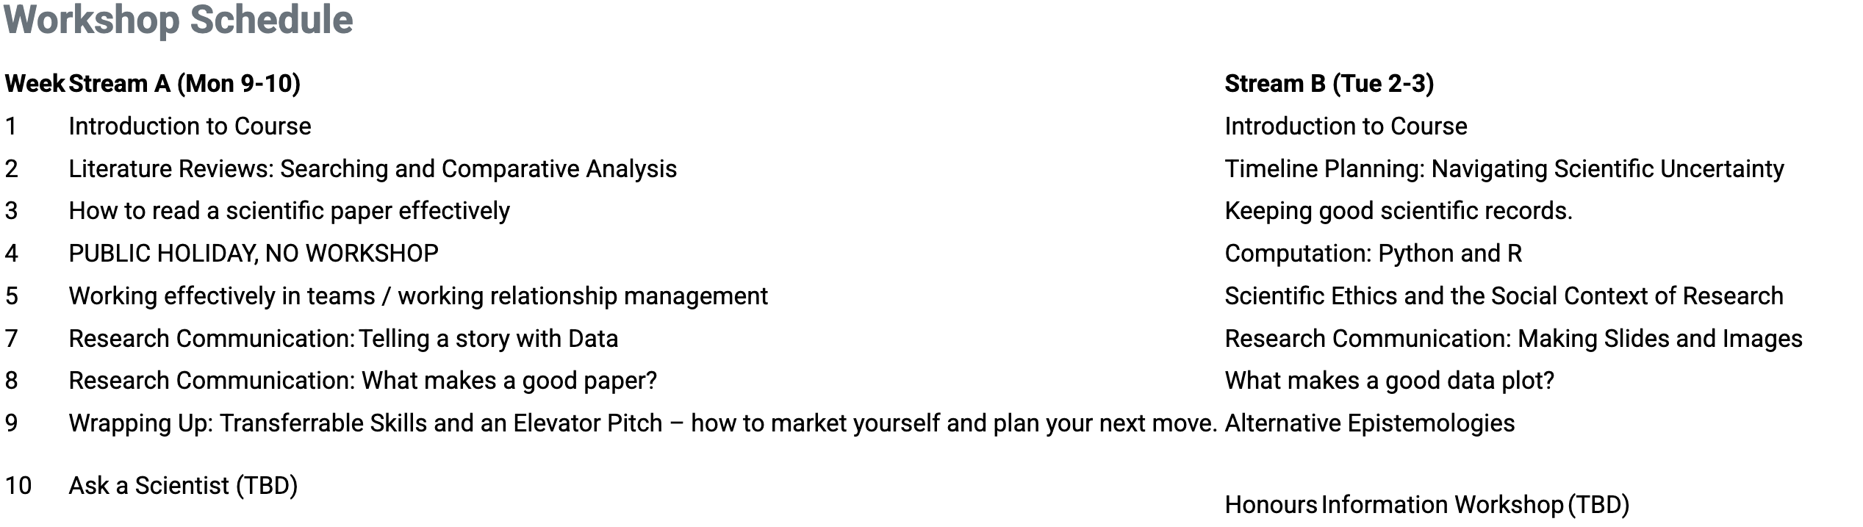
Workshops – Your choices
There are seventeen workshops for this course and you need to attend AT LEAST 10.
You can find the list on moodle.

Slide 14
Activity!
In your groups (or alone) decide what workshops you’re going to attend.
What seem to match the best with your project, or your areas of interest?
You can always attend more than ten :D

Slide 15
Questions?
Ask here

Slide 16
Course ASSESSMENT
All info available in the course outline

Slide 17
It’s Competency-based!
You will get either a “Competent with Merit”, “Competent”, or “Not Yet Competent” based on:
Meeting the attendance requirements (Labs and Workshops)
Your score of CM/CP/NC for all the assessment items.
There are four assessment items for this course:
Lab Work / Project Learning Outcomes
Lit Review / Proposal
Individual Video Presentation
Weekly Quizzes
Get a CP in all four, you’ve passed the course!
Get a CM in any two of 1/2/3, you’ve scored a CM!

Slide 18

Project Learning Outcomes / RESEARCH Techniques
Each lab group will have five Project Specific Learning Outcomes (PSLOs).
You’ll need to get a competent score in each of them – and they’re unique to each project. To get a CM, get a score of CM in at least 3/5 (and CP in the other two)
They are judged by your project mentor at the end of term, with feedback at two points in the term to let you know how you’re going. For most projects this will be in Week 5 and week 8
Further details are in the Course Outline
Photo by Thomas Bormans on Unsplash

Slide 19

Lit Review / Proposal / ResearCh Roadmap
Due in Week 4, a research proposal for your project.
Includes:
  a research question
  lit review
  methodology
  project plan
Marked by your project mentors.
Photo by oxana v on Unsplash

Slide 20

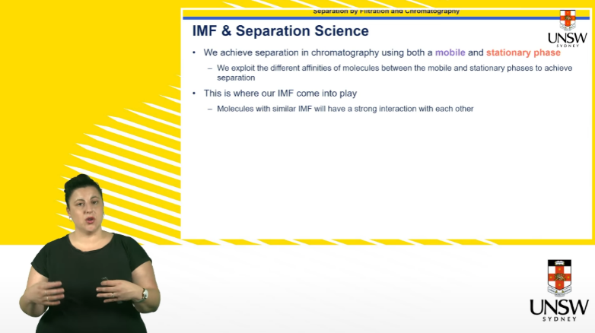
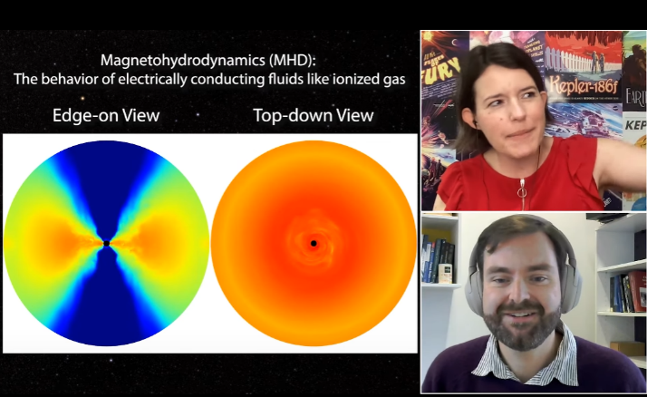
Individual Video / Research Spotlight
In Exam Week (first day of), submit a 6 minute video on your research approach, results, and implications.
You need to include graphical depiction of your research approach and results.
There will be the chance to review, practice with your mentors and peers.
Marking rubric on Moodle– marked by your mentors.

Slide 21
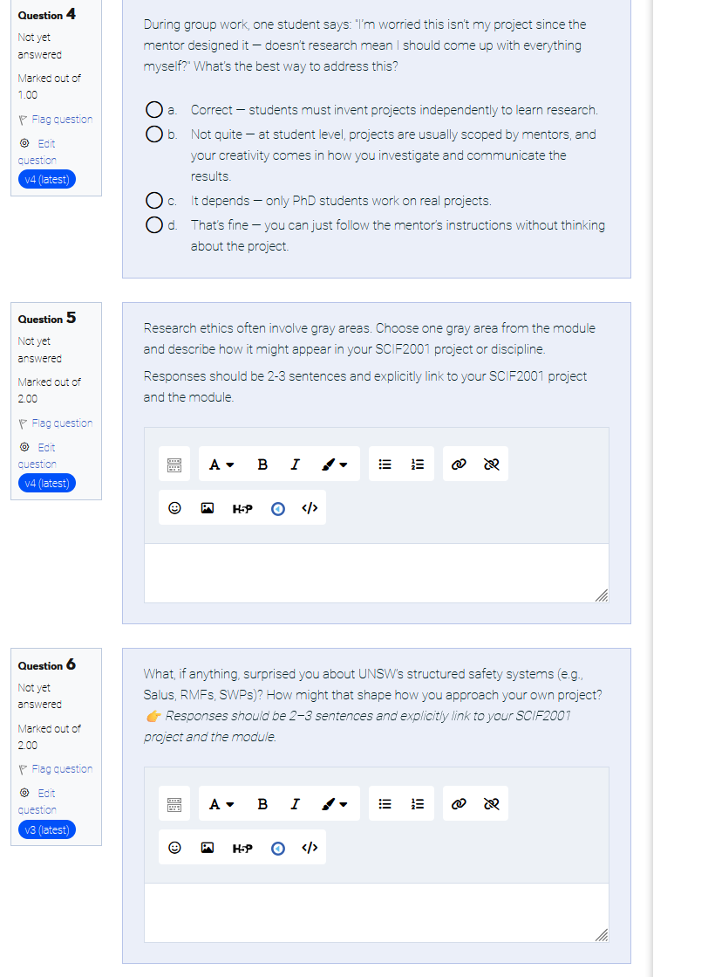
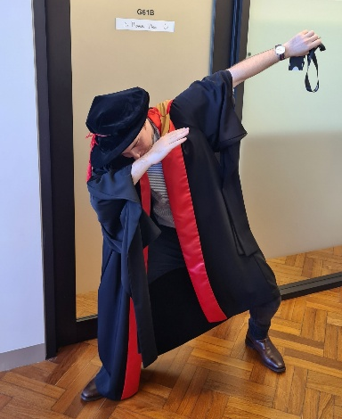
Weekly Quizzes / Research Toolkit
Reflections tied to each workshop, each graded on Moodle.
You need a cumulative total of 50% or more to pass.
Short, reflective, graded automatically or by Tom

Slide 22
Your Project Teams
Who are you working with, and how do you contact them?

Slide 23
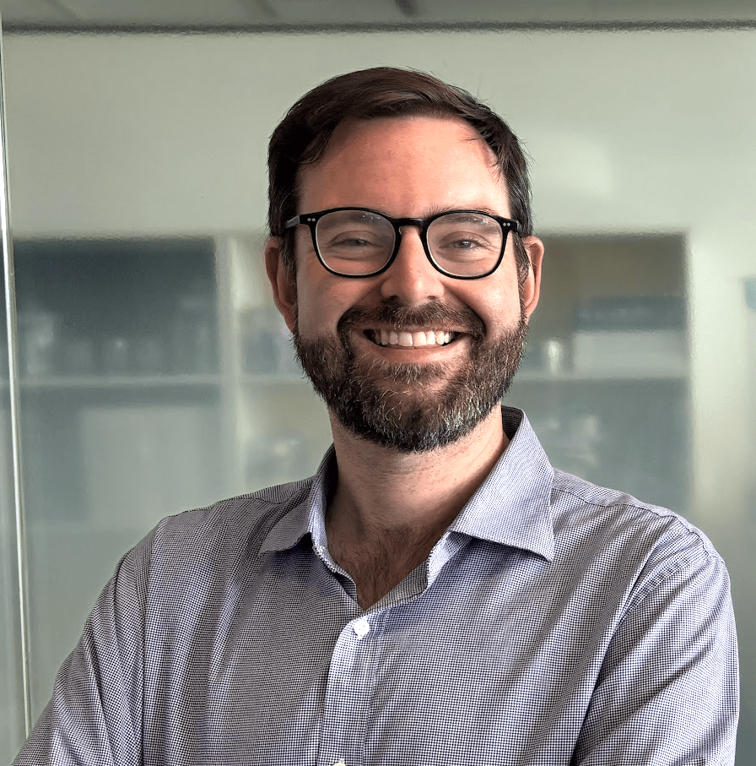
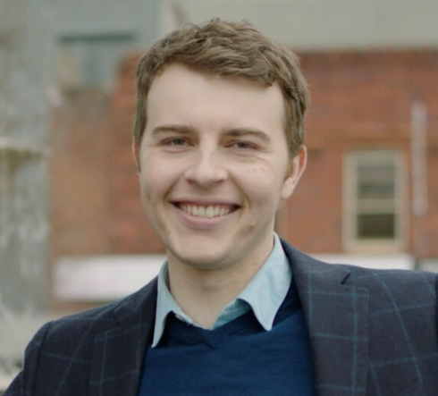
The Course Contacts
Dr Ben Montet
b.montet@unsw.edu.au
Dr Thomas Dixon
Thomas.Dixon
@unsw.edu.au
Workshop +
Content Developer
Marking Quizzes
Handling ELPs
Course Convenor

Slide 24
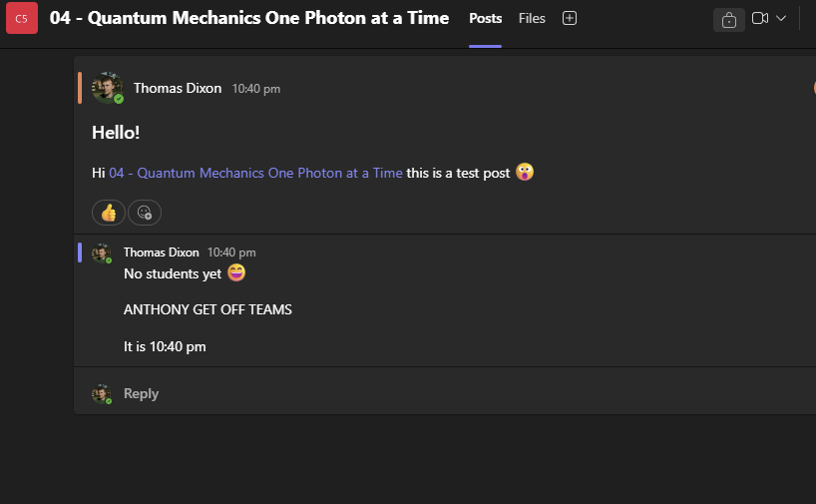
Microsoft Teams
You are in a Microsoft Teams Channel for your research project.
This will be how you can communicate with your team – but you can also use email if you like!
Teams also has file storage – your mentors might have some reading material for you there (and you can use it to cloud store notes!)

Slide 25
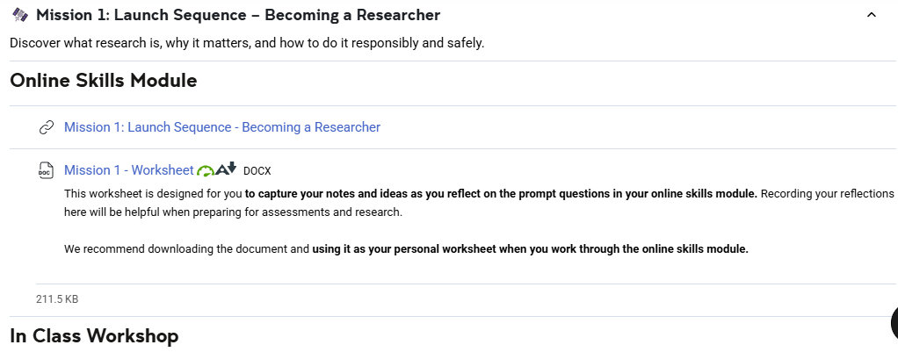
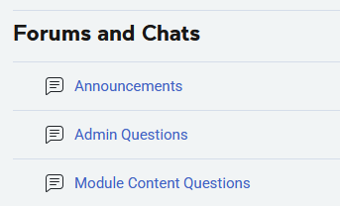
Moodle Forums
We’ve got a couple of Moodle forums you can ask whole cohort questions in.
Announcements and information about workshops and modules will be provided on Moodle
Most of the whole cohort material are accessed via Moodle.

Slide 26
Questions?
Ask here

Slide 27

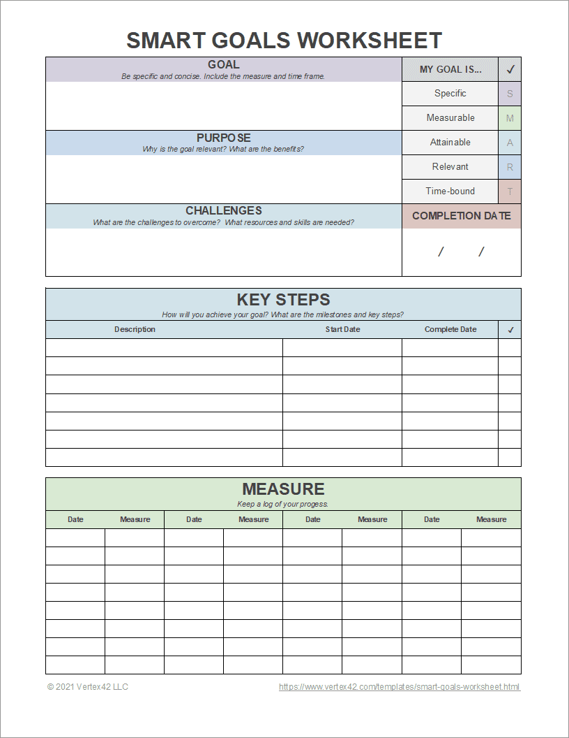
Activity Two: Plan Ahead!
Your first meeting with your research mentor is (probably) next week.
Now is a good time to think about – what resources, pre-reading etc.
Discuss in your groups; what do you think you should be doing to prepare for next week?
Photo by Knut on Adobe Stock
Not sure how to start this?
Consider a readymade template:
http://bit.ly/3VPthQ9

